Slide 1
WEB PROGRAMMING II Final Viva
Name : M.R.P.N.Tharuksha Rajapaksha
NIC : 200019401866
BCU Student ID : 22178965
SCN No : 207977608
Batch : Java Institute Griffins Batch

Slide 2

NDCamera E-Commerce Web Application
NDCamera is a Camera Item Selling E-Commerce Web Application.

Slide 3
This Web Application Has Following Features
Home
Sign in/Sign up/Sign Out
Profile
Search
Brands
Products
Product Information
Wish List
Cart
Checkout
Payments
Blog
Contacts
Drop Down Menu
Header Navigation Menu
Admin Panel

Slide 4
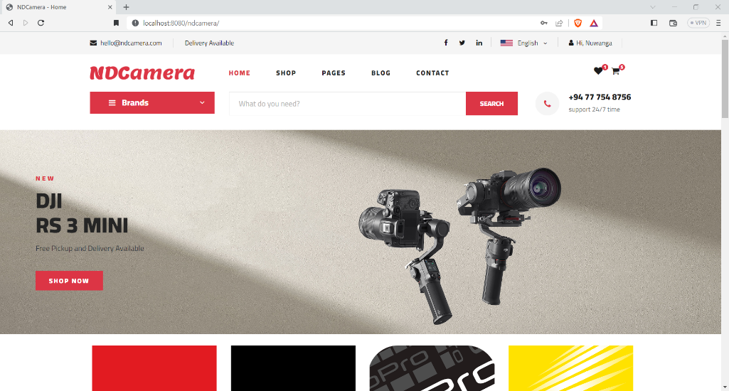
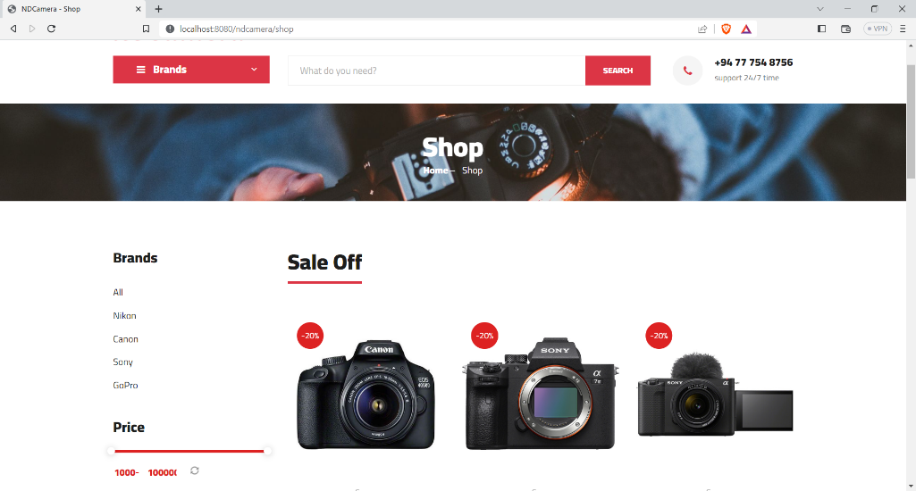
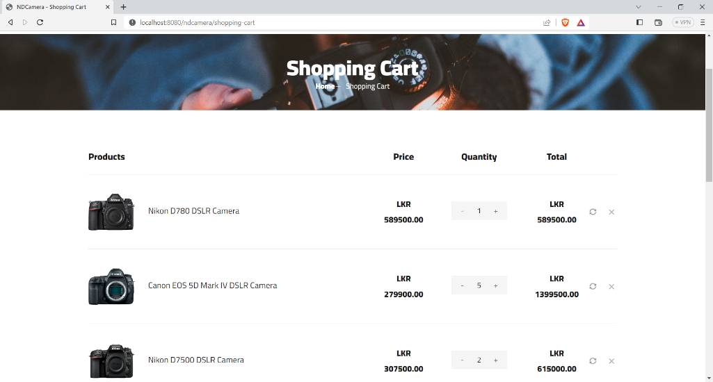
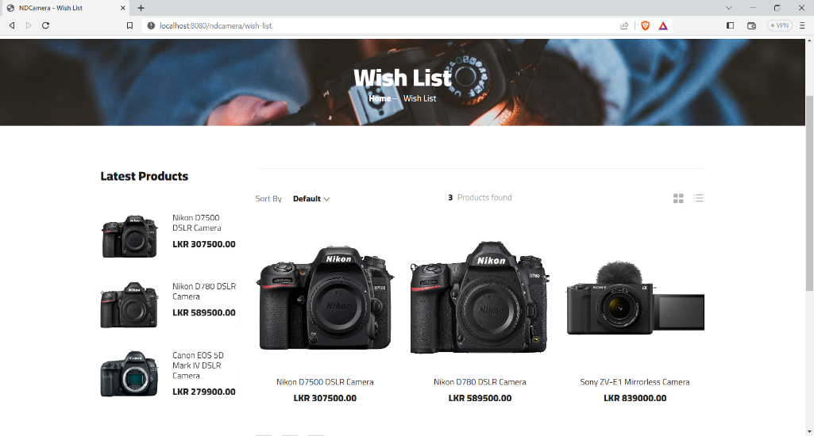
Uis

Slide 5
Thank You !

